Slide 1


Slide 2







Problem Identification
Market Challenges:
Core Problem:
Poor skincare literacy- long term care undervalued
Saturated Market -Crowded field, foreign control, little room to stand out
Consumer Looks for cheaper alternatives- turning premium positioning into adoption hurdles
Consumers distrust local premium sunscreens, favor foreign brands, and see sunscreen as optional rather than essential
Trust Barriers
Widespread fake cosmetics have made consumers skeptical for all brands especially local ones.
Consumer perceive local skincare as risky, not reliable

Slide 3



Target Group or Buyer Persona
Target Group
Name: Anika
University Student
Hate White Cast
Trust gap
Women | 18-34 | Urban
Men | 22-30 | Urban
Students | 18-22 | Both
Name: Rafi
Junior Officer
Avoids skincare
Thinks Its for Women

Slide 4

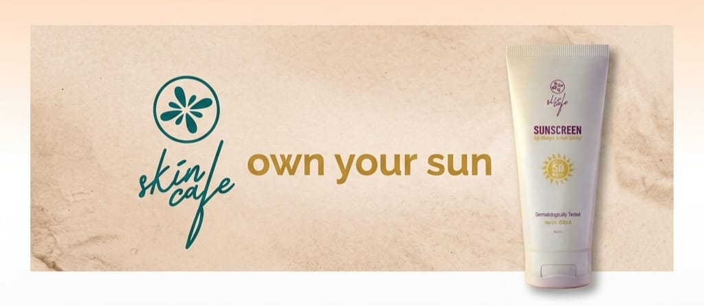
The Big Idea
Own Your SUN
The Tagline
“ No more sunburn because you Own your SUN ”
It tells the consumer - You don't have to hide from the sun to avoid getting burned; you just have to take control of it

Slide 5
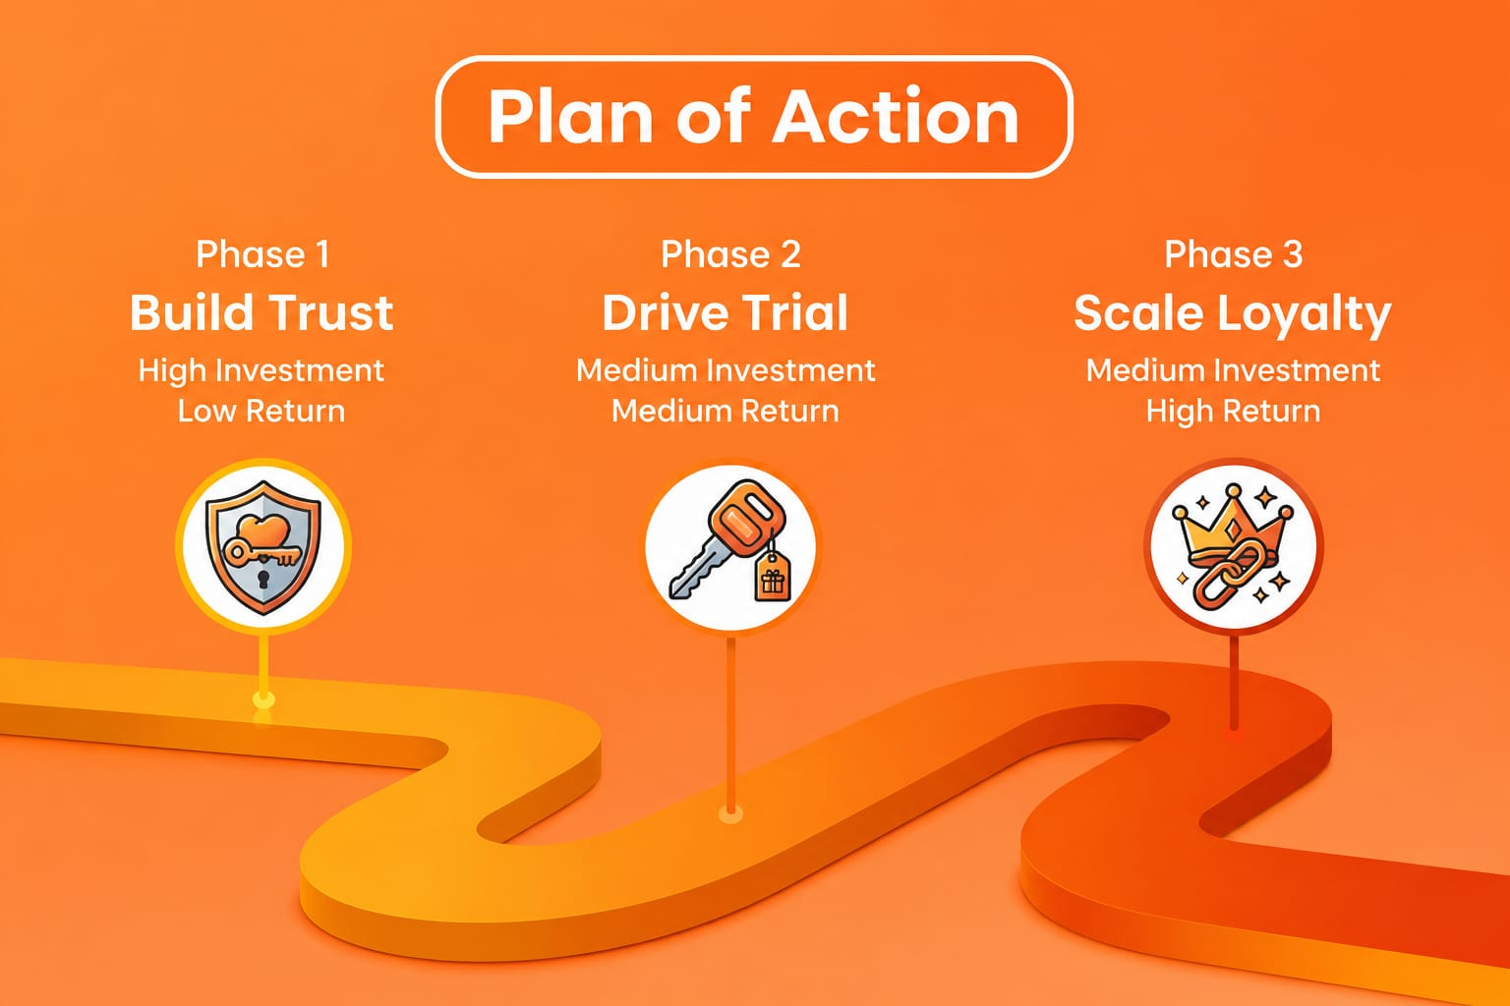
Plan Of Action For 12 Month

Slide 6
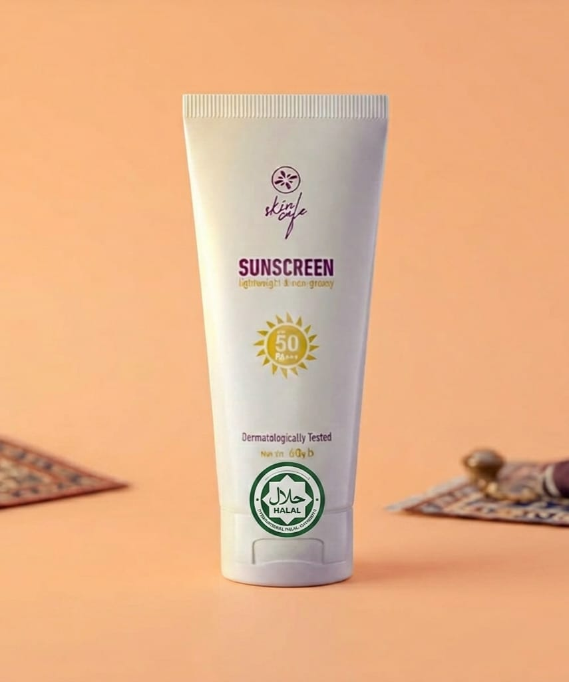
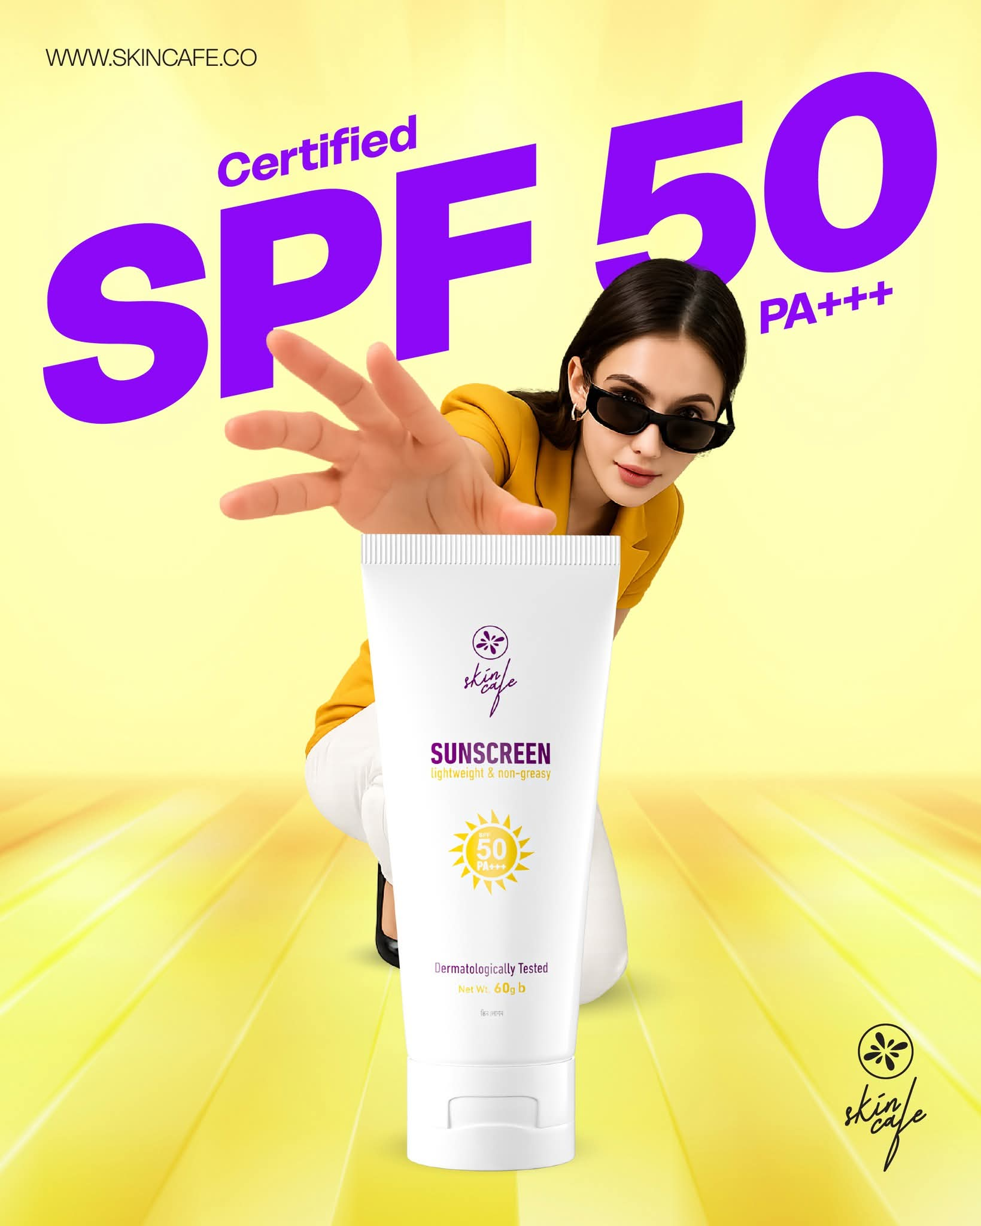
Certification
“ Everybody believes the label ”
Highlight Halal Certification
Build Reliability
Attract Mass Target Group
Added Value Proposition

Slide 7
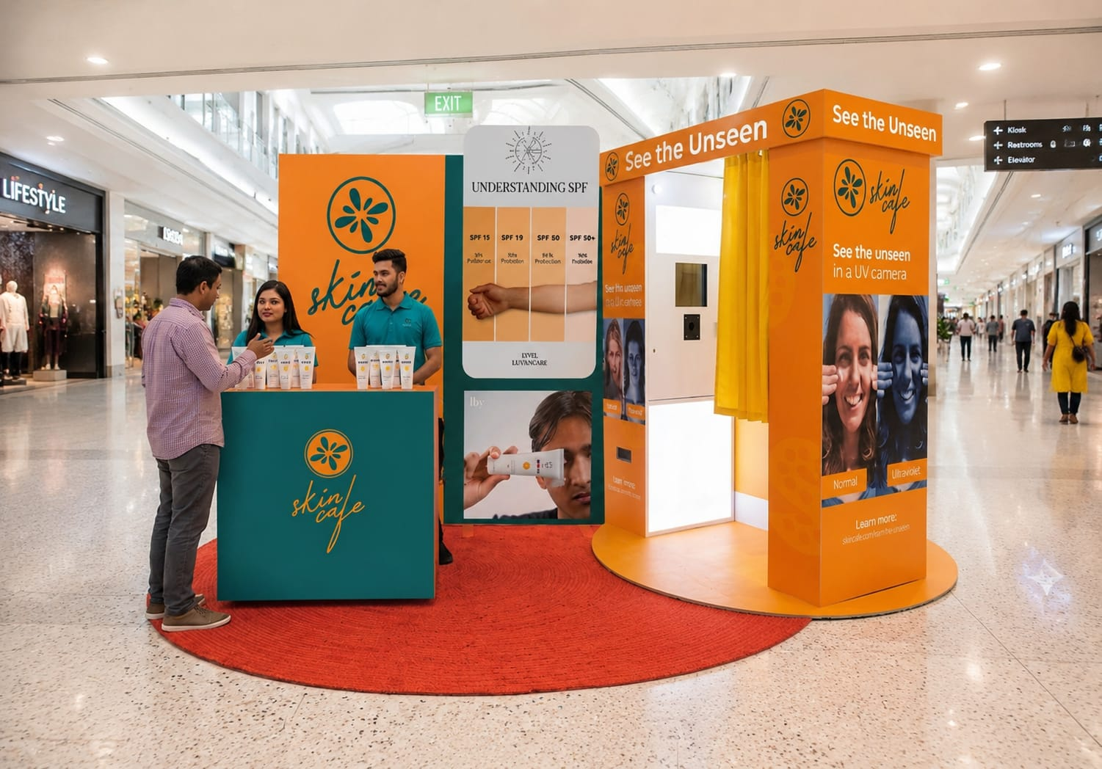
See The Unseen Campaign
See The Unseen Campaign Addresses the low consumer awareness and “Sunscreen is only for summer” misconceptions by physically proving UV damage

Slide 8

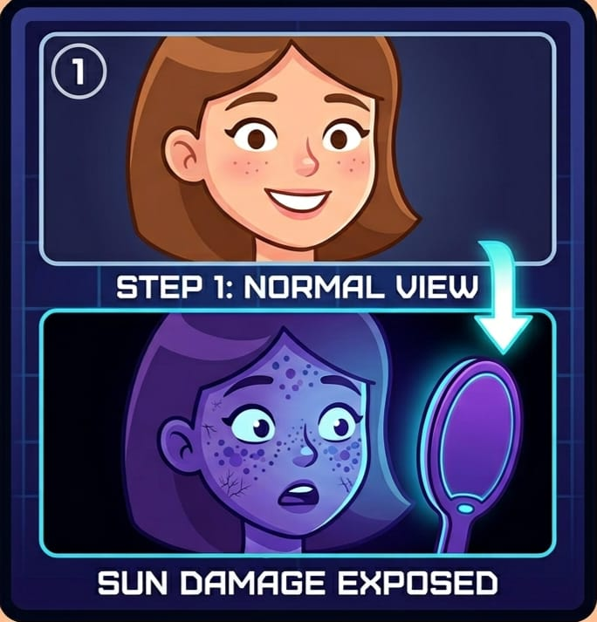
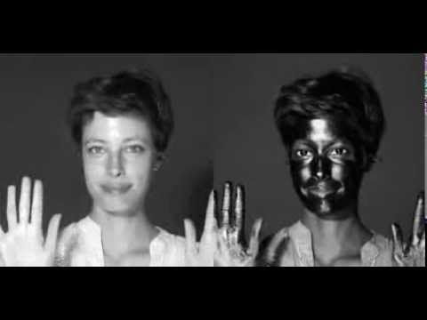
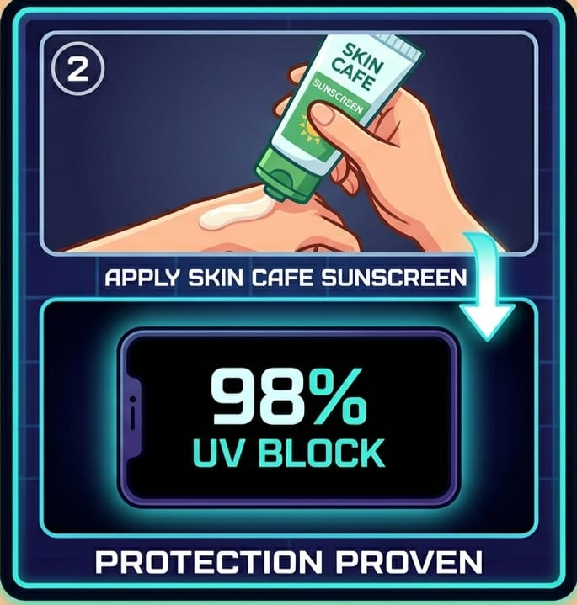
Step 1 (Reveal): Bare face under UV mirror → hidden pigmentation & sun damage exposed.
Step 3 (Selfie & Capture): Take split-screen “before vs after” selfie
Step 2 (Protection): Apply Skin Cafe Sunscreen → screen shows it go completely black, proving 98% UV block.
Step 4 (Viral Loop):
Scan QR code → post to FB/IG with #skincafeUVchallenge #funfriday #beforevsafter #skincafe #seentheunseen + tag Skin Cafe to get digital photo.

Slide 9
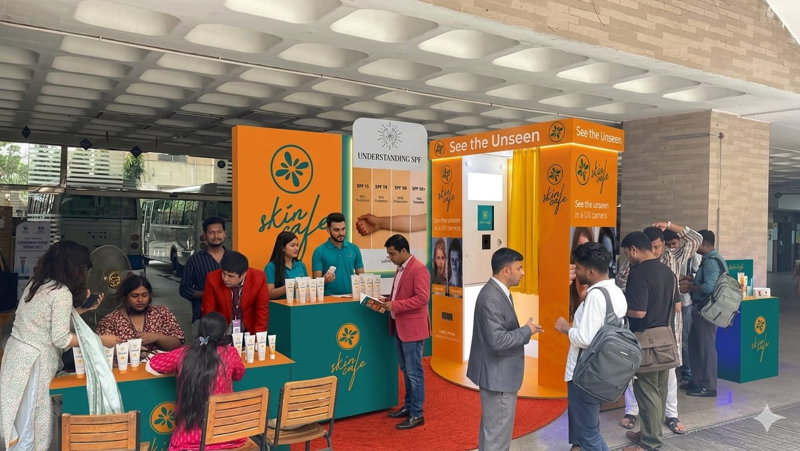
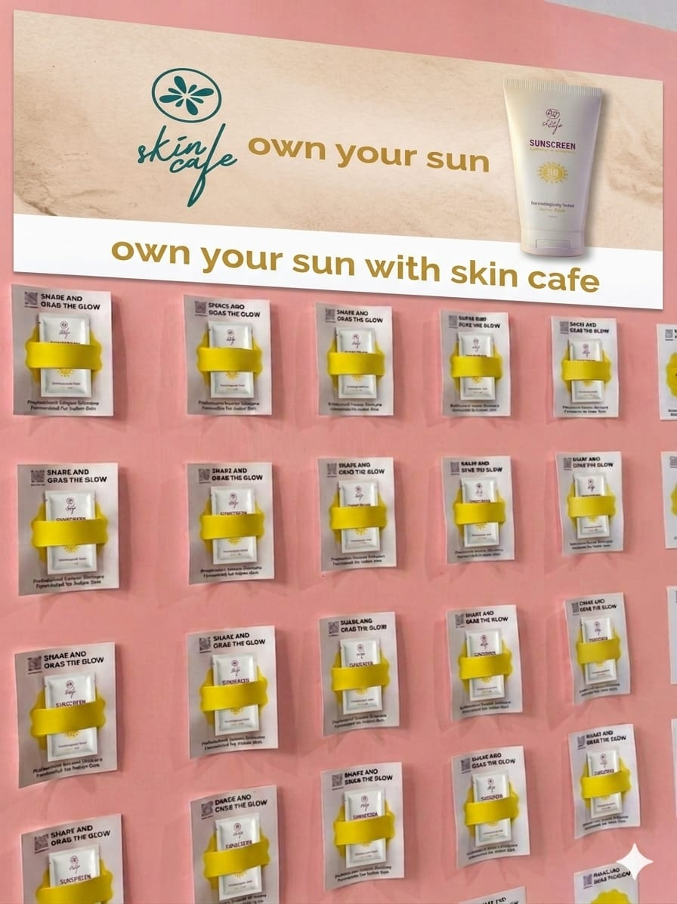

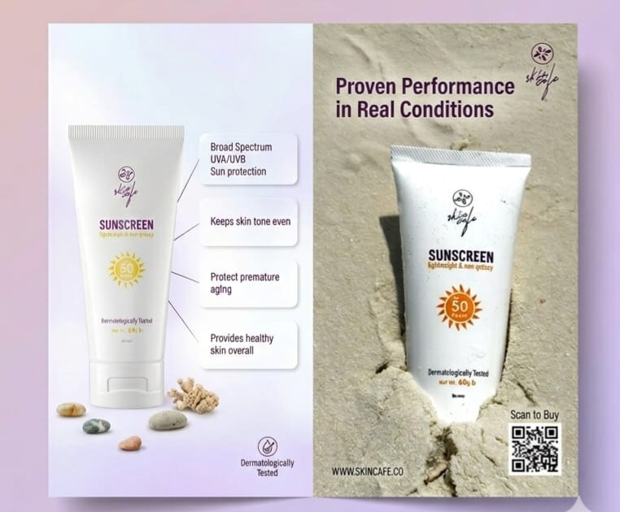
Raise awareness about sun damage in different areas with a dermatologist-led UV skin test booth. Educate participants and give them goodies, leaflets
UV Selfie Gift:
The most creative selfie wins a 6 month 30% discount card for anything at Skin Cafe. Winners are announced Second and Fourth #FunFriday of the month. Cards are delivered online with the discount timeline.
“Peel And Protect”
Wall
Flyer Marketing

Slide 10
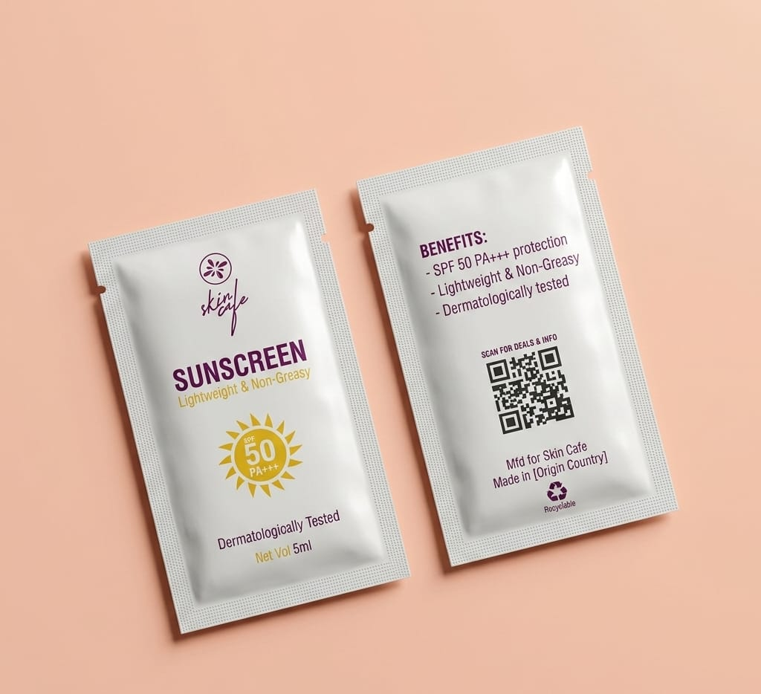
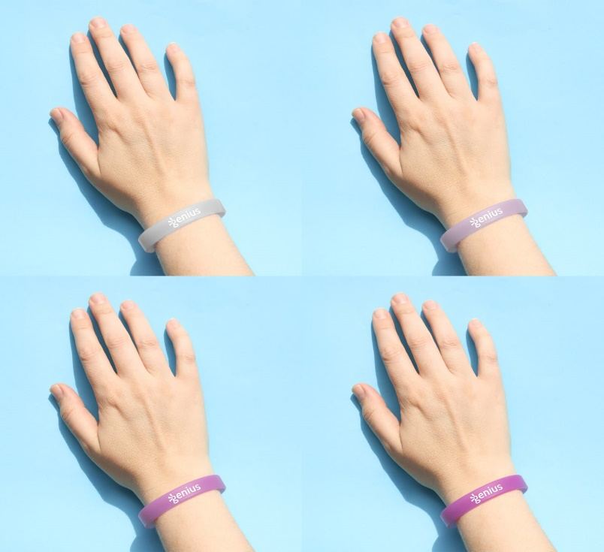
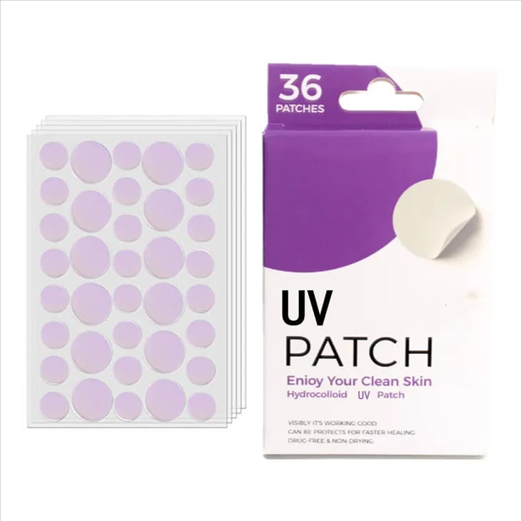
Goodies Distribution
5ml Single use sample sachet
Silicon Bands that changes color when exposed to harsh UV Light
Mini UV Detection Stickers

Slide 11
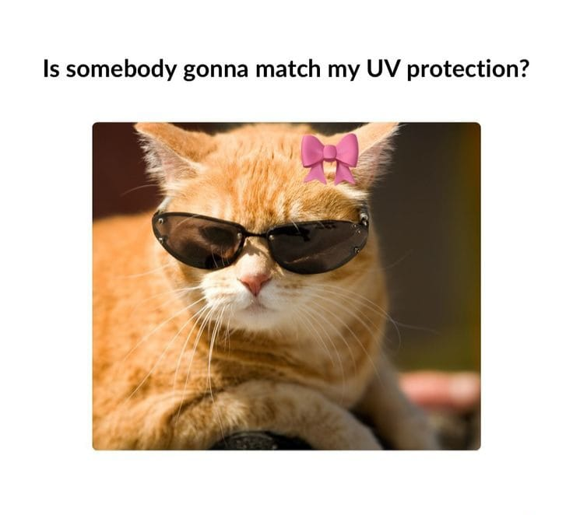
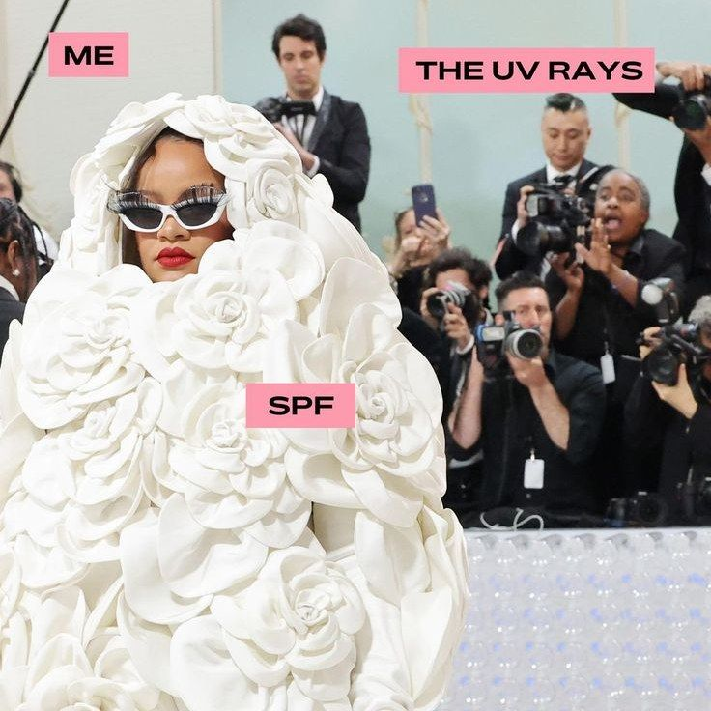
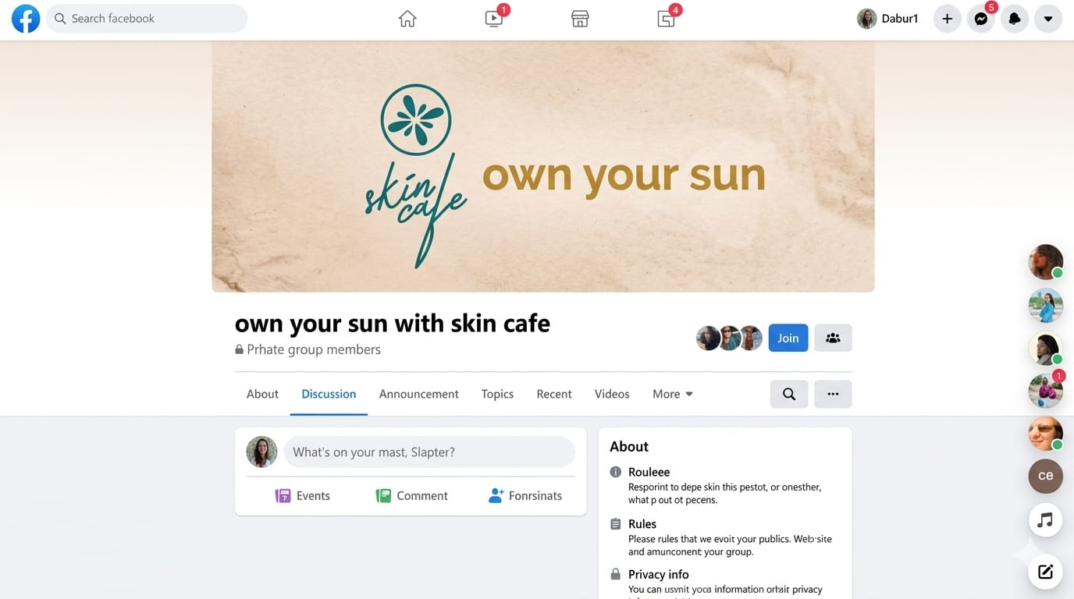
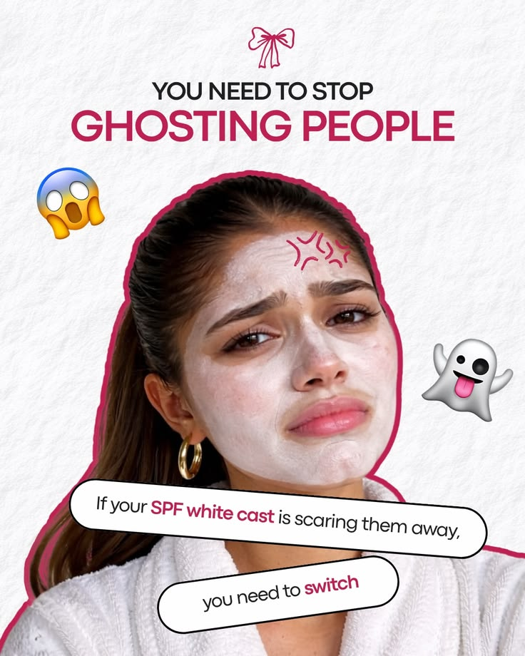
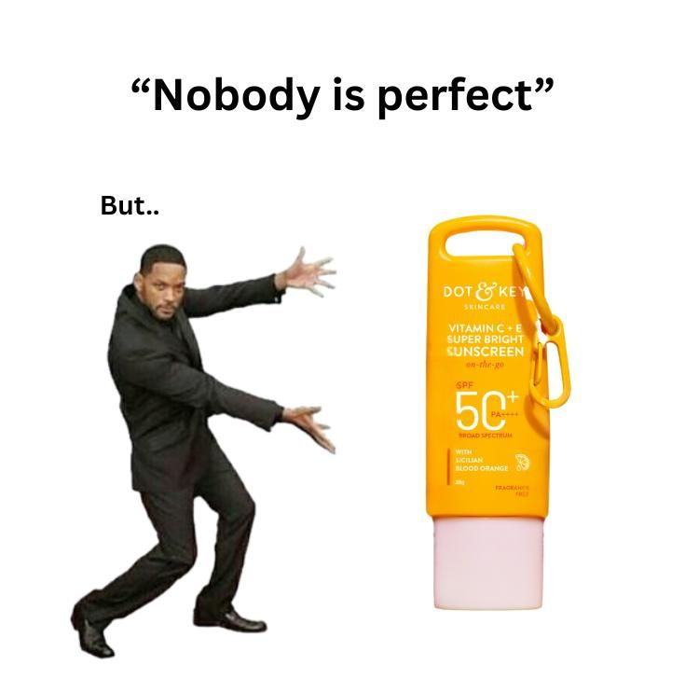
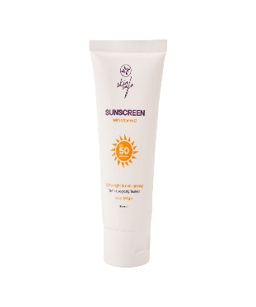
Facebook Community Building
Content Engine:
Sharing memes and realism
Interactive Polls
Skincare tips

Slide 12
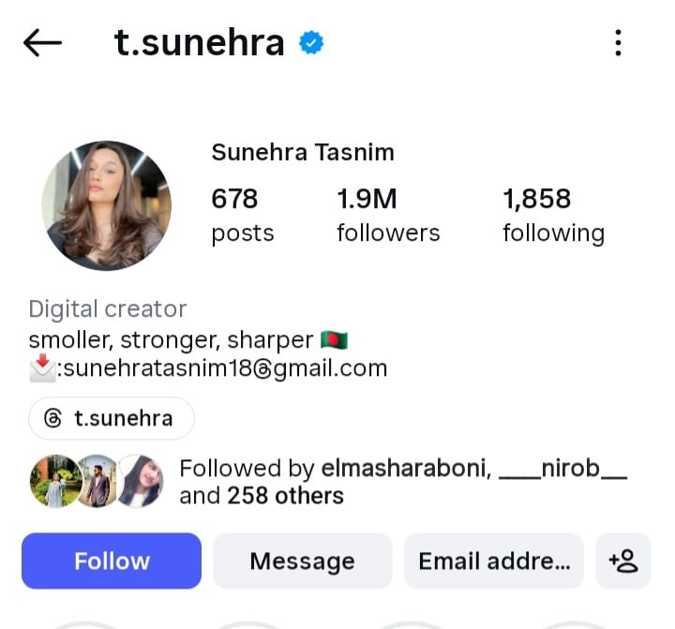
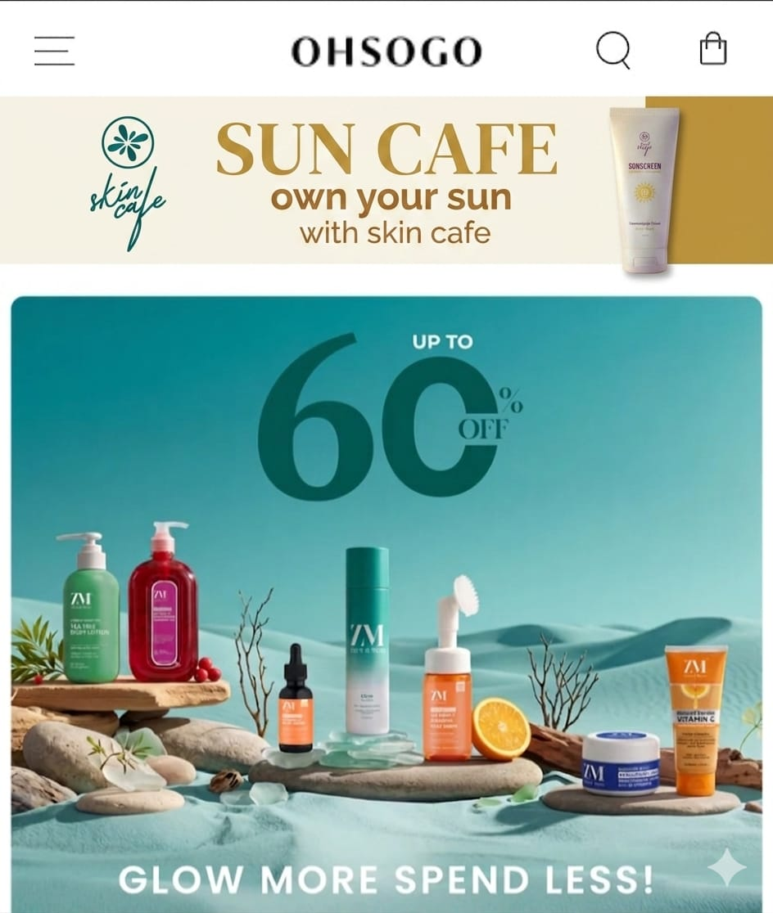
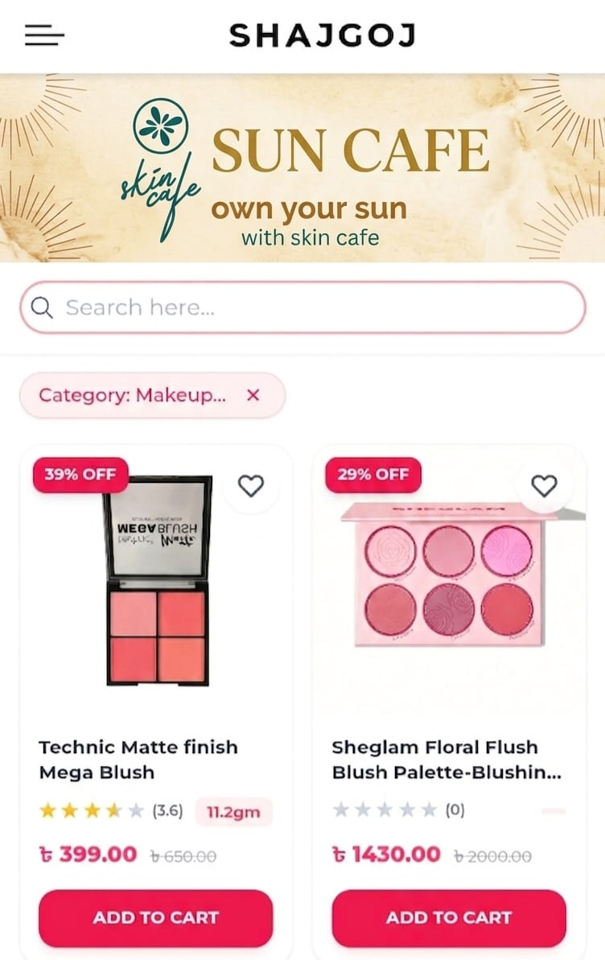
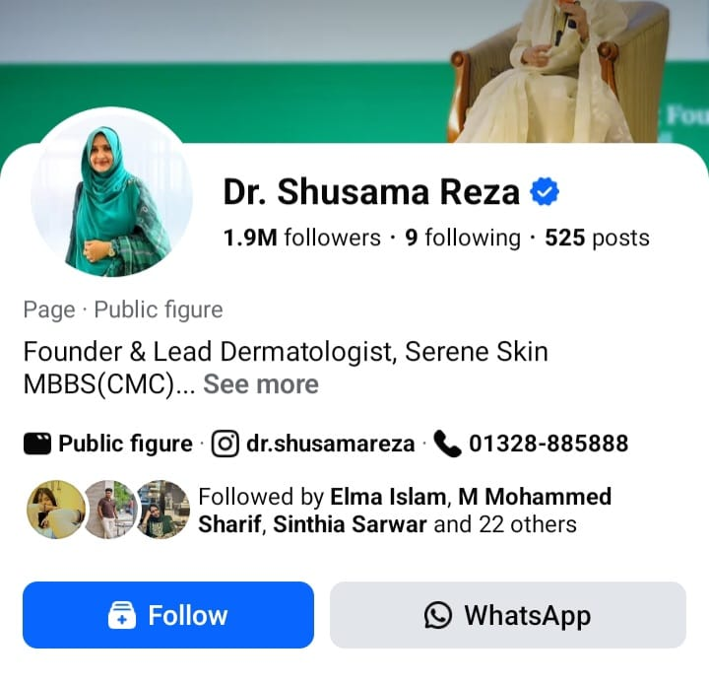
Influencer Marketing
E-Commerce
Target Group based
Influencer marketing
GDN Banner
Beauty
Health

Slide 13
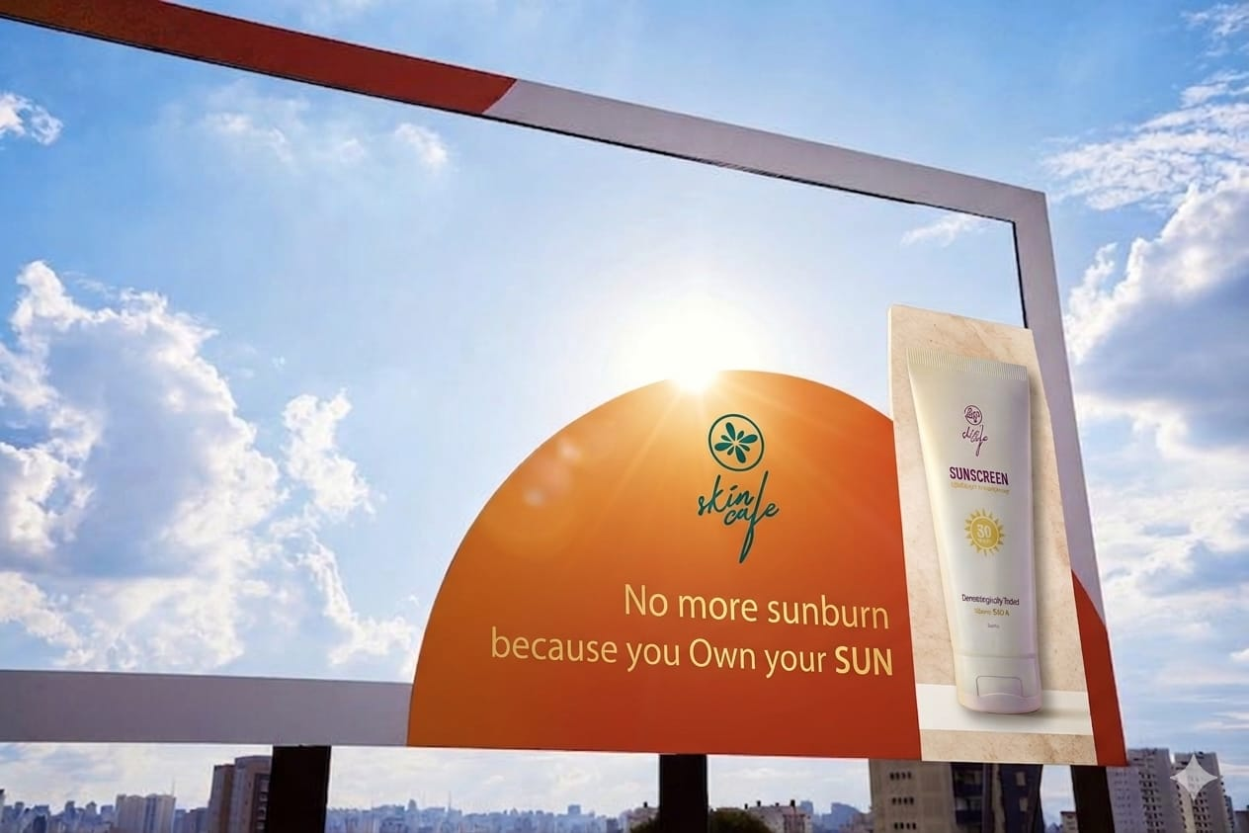
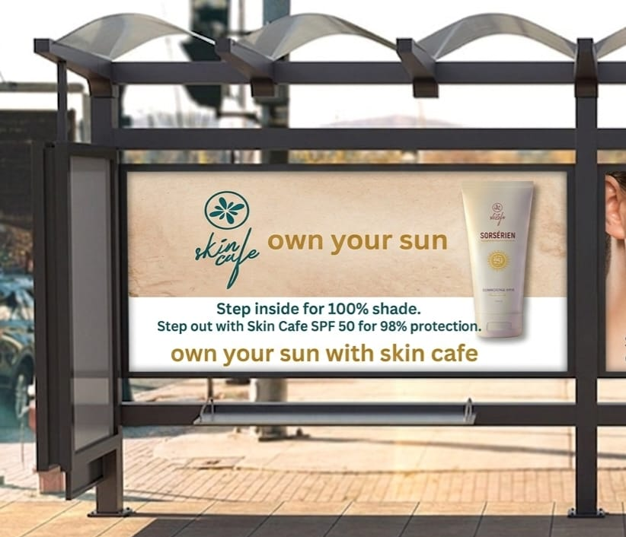
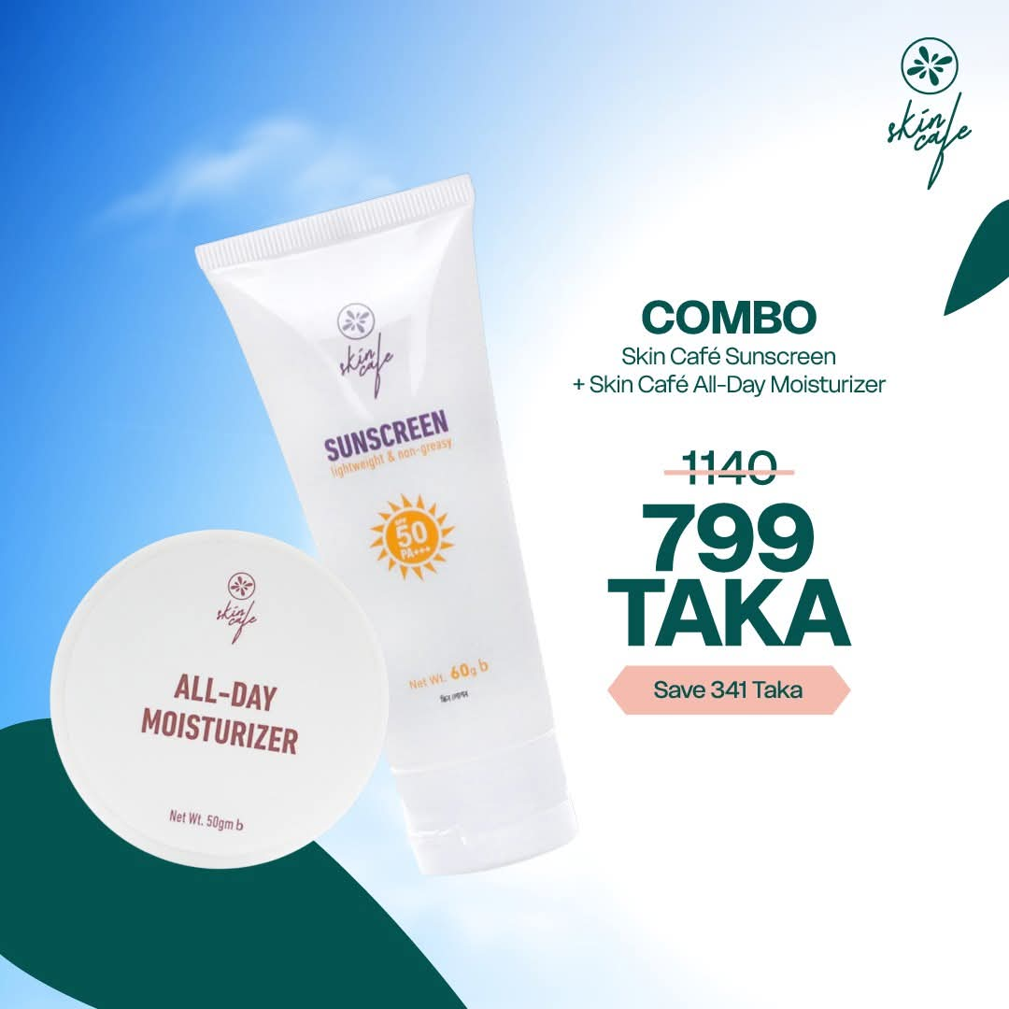
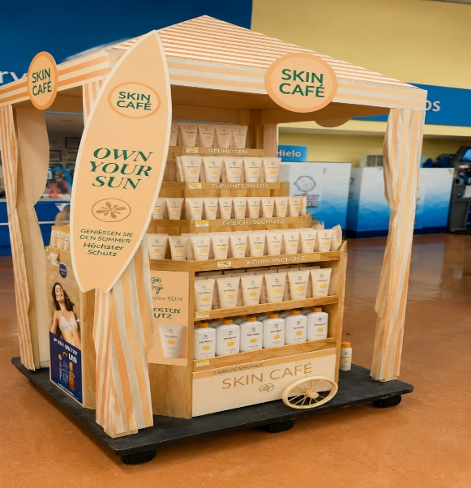
Affiliate Marketing
Ensuring Visibility
Google Web Pop-Up
YouTube Overlay
Facebook Sponsored Post

Slide 14
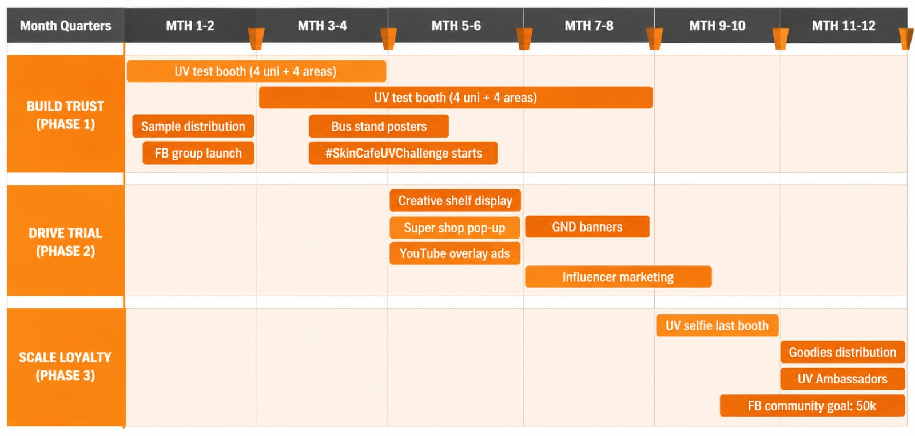
Roadmap and Timeline

Slide 15
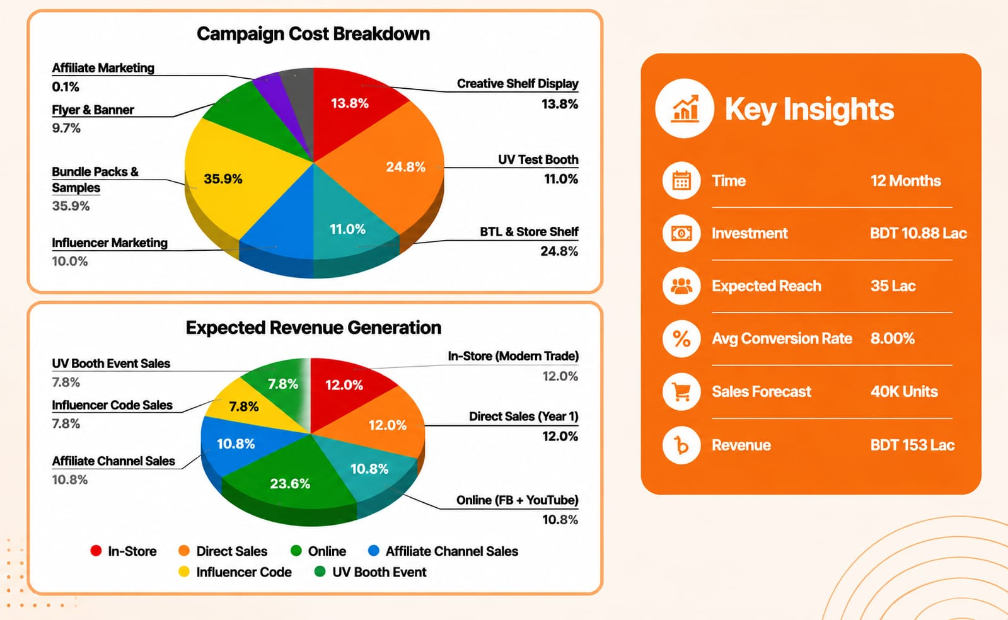
Financial Breakdown

Slide 16
Feasibility and Practicality
Low Consumer Trust in Local Brands
UV test booth activations + Dermatologist+ Halal certification display
Low Daily Sunscreen Usage Habit
Year-round UV awareness campaigns + Seasonal messaging
High Market Competition (Local + International)
Climate-appropriate formula + No white cast + SPF 50 PA+++ at competitive price (BDT 650
Counterfeit Products Damaging Brand Confidence
Tamper-proof packaging + QR code verification on every tube
Limited Awareness of UV Damage
UV camera selfie booths + Social media contest #seentheunseen
All challenges addressable with proposed strategies – No major execution barriers.

Slide 17
Thank You

